Slide 1

TestNG Framework & Overview
Deepak Tripathi

Slide 2
What is TestNG:
TestNG is a testing framework build on the top of JUnit to simplify and improve JUnit testing framework for java.this can be used for both Unit testing and End to End testing.
It is an open source framework which is build on the top of both JUnit and NUnit but with some new functionalists the make it easier to use.
It can be used for any testing, be it API testing or UI testing.
In TestNG, Test means test and NG means Next Generation.

Slide 3
Why TestNG:
Selenium is a tool which can automate any user/browser interaction. Although selenium is able to do such magic stuffs, there are something which selenium can't do.
For example : - Say you need to take a piece of code and name it as a test case. Similarly you need to combine multiple tests into a test suite. At the end of every test run, you need a nice report of what tests pass/fail. You need to integrate this with your build system. This is where TESTNG comes and is used for!
TESTNG can help to read data from excel files, can generate reports and also can write logs.

Slide 4
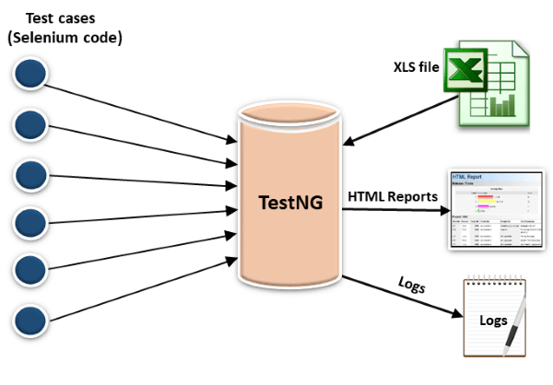
Why TestNG:

Slide 5
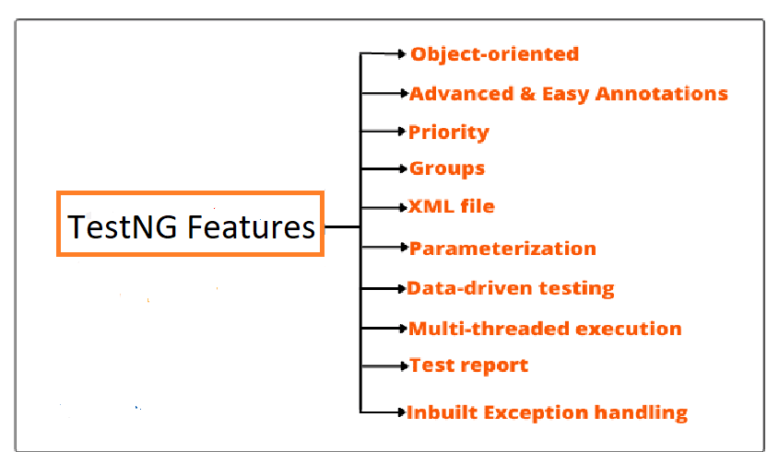
Features of TestNG

Slide 6
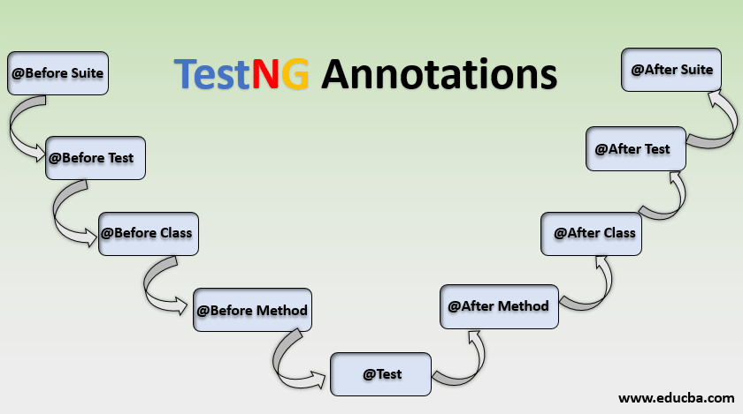
TestNG Annontations:
TestNG Annotation is a piece of code which is inserted inside a program or business logic used to control the flow of execution of test method.

Slide 7
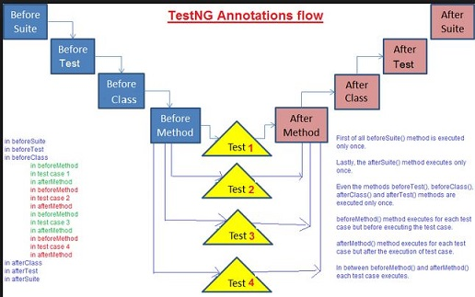
TestNG Annotations Flow:

Slide 8
TestNG Annotations Example
We will know check the example of how to use TestNG Annotations.
The example below verifies the title of the Browserstack Home Page.
The entire test case has been split into 3 parts.
Launching the browser will be the first step and hence it is included under the @BeforeTest Annotation.
Next is the actual test case which verifies the title, and is therefore included in the @Test annotation.
Finally, the quit browser test case is considered under the @AfterTest annotation.

Slide 9
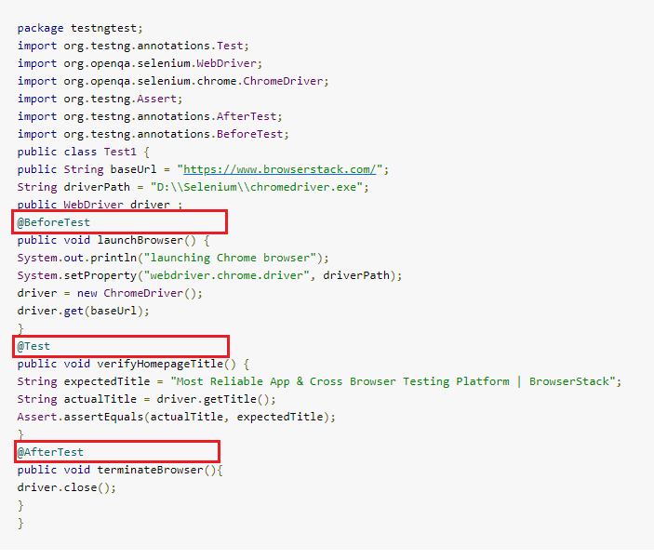
TestNG Annotations Example

Slide 10
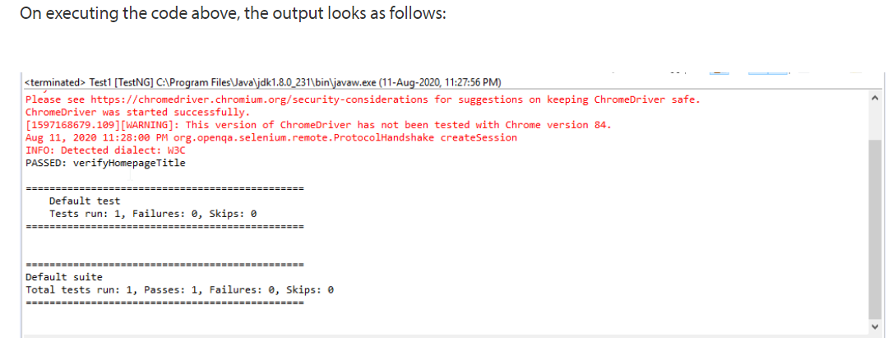
TestNG Annotations Example

Slide 11
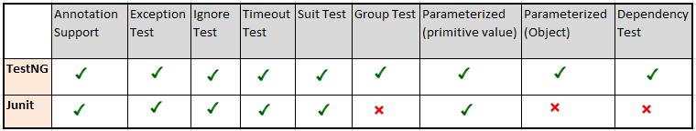
TestNG VS JUnit
TestNG can do a lot more complex automation testing, because of its ability of grouping test cases and executing these groups.
For eg, if you have defined many test cases and assigned them to 2 different groups, you can execute any particular group passing its name to TestNG.
Unlike TestNG, Junit cannot perform Group tests, have objects as parameters, or have dependencies between methods.
Following are some basic comparison for TestNG VS JUnit

Slide 12
TestNG XML File
TestNG.xml file is a configuration file that helps in organizing our tests. It allows testers to create and handle multiple test classes, define test suites and tests.
It makes a tester’s job easier by controlling the execution of tests by putting all the test cases together and run it under one XML file.
Advantages of TestNG.xml
It provides parallel execution of test methods.
It allows the dependency of one test method on another test method.
It helps in prioritizing our test methods.
It allows grouping of test methods into test groups.
It supports the parameterization of test cases using @Parameters annotation.
It helps in Data-driven testing using @DataProvider annotation.
It has different types of assertions that help in validating the expected results with the actual results.
It has different types of HTML reports, Extent reports, etc. for a better and clear understanding of our test summary.
It has listeners who help in creating logs.

Slide 13
Prioritizing the test cases with TestNG
Prioritization of test cases is one of the major factors for performing the test execution. We can prioritize the test cases depending on the criticality of an application and the business impact of the same. The test suite can be extensively reduced by setting priority on the test case selection.
We can set priority for test cases in order of their execution, by giving priority to each test method. A test method having lower priority runs first then the test methods with higher priority are executed.
If test priority is not defined while, running multiple test cases, TestNG assigns all @Test a priority as zero(0).
Case-sensitive in TestNG
Just for your information there is a standard syntax for defining priority in testNG i.e. @Test (priority=4), suppose you are defining it in some other syntax say @Test (PRIORITY=1) then your IDE will show it as a compilation error.

Slide 14
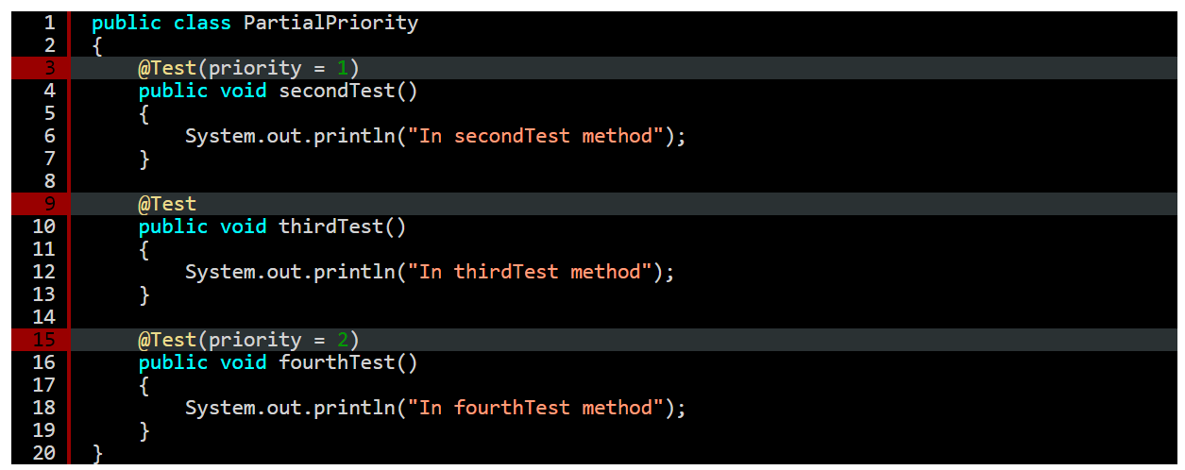
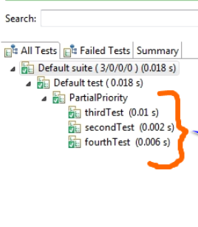

Example of Prioritizing Test Cases

Slide 15
TestNG Groups
As the name indicates, grouping in TestNG lets you group multiple test methods in named groups. Through groups in TestNG, you can run a particular set of tests that belong to a group or multiple groups.
Consider a scenario where the test suite comprises different test types, e.g., unit test, integration test, smoke test, etc. Instead of adding all the test scenarios in a single test suite (or multiple test suites), you can perform ‘grouping’ test methods. This helps in segregating the test scenarios into different test categories – test type (e.g., smoke, functional, etc.), functionality being tested (login, checkout, etc.), and test combinations (e.g., browser set to Chrome, Firefox on Windows 10, etc.).
TestNG groups are used for:
Declaring methods that belong to groups.
Specifying groups that contain other groups.
Running tests within the same group or multiple groups.
Including (or excluding) tests in a group.
Including a certain set of groups (or regular expressions) while excluding another group
Running tests that depend on the other tests and avoiding unnecessary test execution if the dependent test has failed.

Slide 16
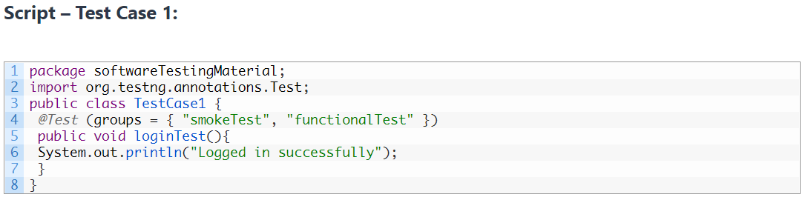
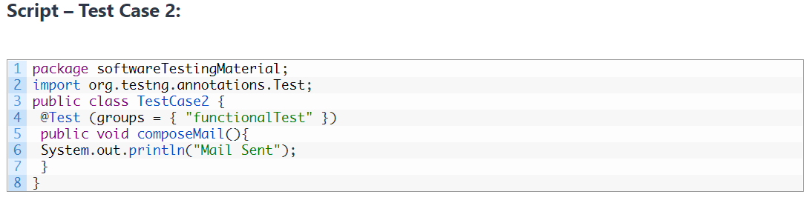
TestNG Groups Examples

Slide 17
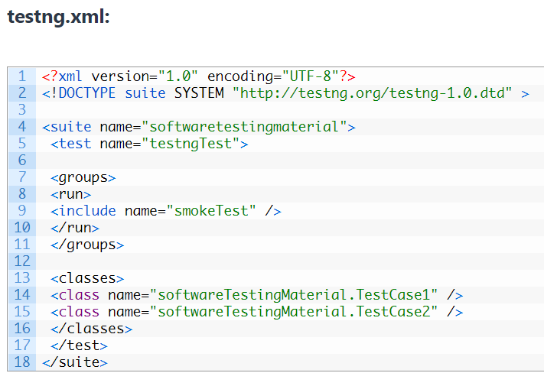
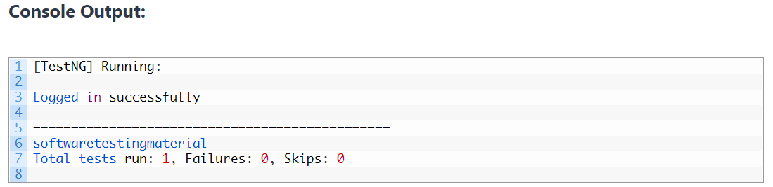
TestNG Groups Examples

Slide 18
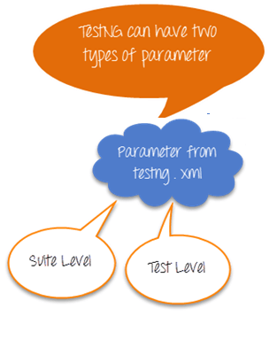

Parameterization using testng.xml
Parameterization in Selenium is a process to parameterize the test scripts in order to pass multiple data to the application at runtime.
It is a strategy of execution which automatically runs test cases multiple times using different values. The concept achieved by parameterizing the test scripts is called Data Driven Testing.
TestNG allows the user to pass values to test methods as arguments by using parameter annotations through testng.xml file.

Slide 19
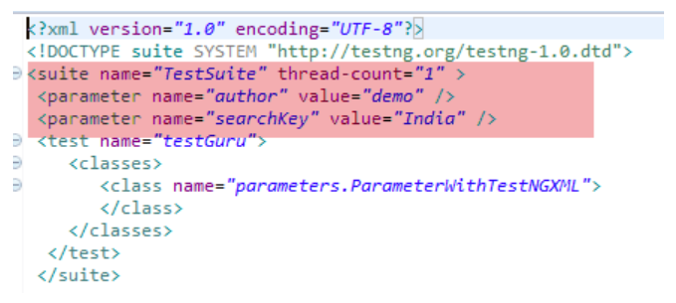
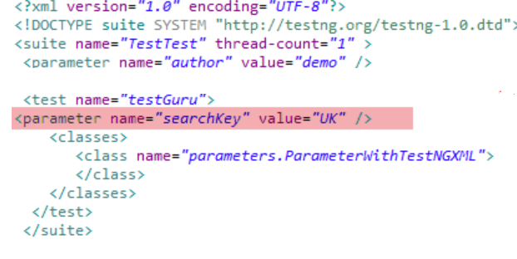
Parameterization using testng.xml
Parameters can be defined at 2 levels
Suite level – The parameters inside the <suite> tag of TestNG XML file will be a suite level parameter.
Test Level -- The parameters inside the <Test> tag of testing XML file will be a Test level parameter.
Suite Level
Test Level

Slide 20
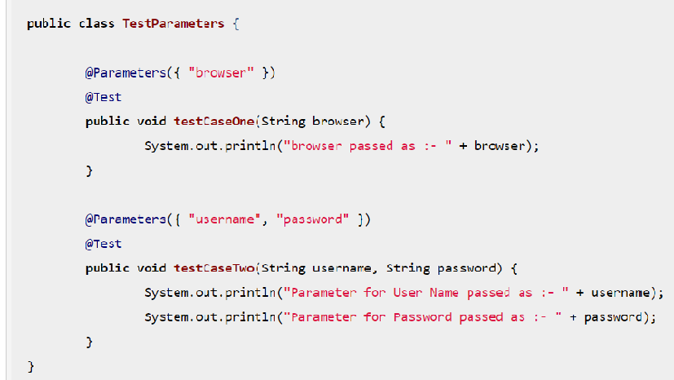
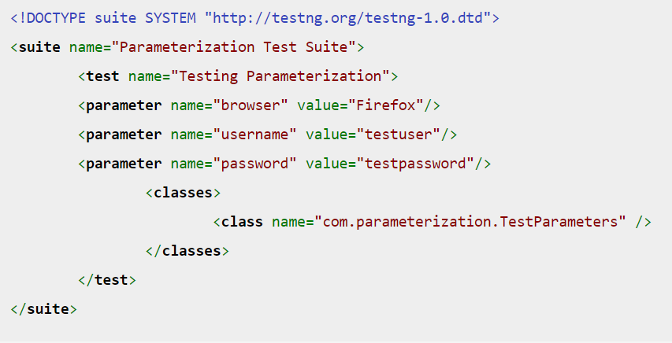
Example of parameterization
Test Method 'testCaseOne',

Slide 21
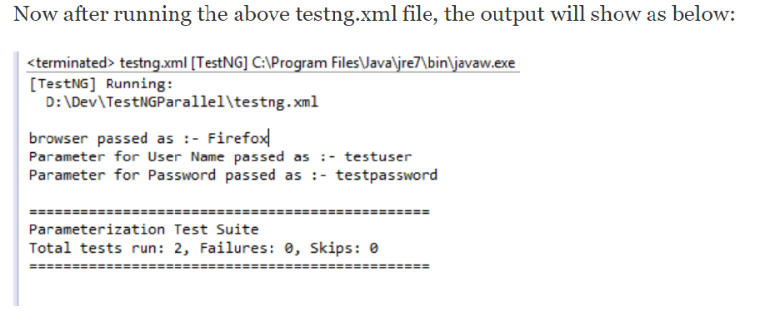
Example of parameterization

Slide 22
TestNG Parallel Execution
Parallel testing or parallel execution, as the name suggests, is a process of running the test case parallelly rather than one after the other.
In parallel testing, the program’s multiple parts (or modules) execute together, saving the testers a lot of time and effort.
As an example, you can think of having software with two different versions and running them in parallel with the help of TestNG. Parallel execution would give us the correct idea of the stability and performance of the software much faster than running serially.
Parallel testing is used heavily with Selenium because of the importance of cross-browser testing in the market today. If we have so many browsers with a different version, we can just create a browser matrix and run the tests parallelly, saving us a ton of resources such as time.

Slide 23
Advantages of Parallel Execution
.If we look at the bigger picture, parallel testing has the following advantages:
Reduces Time
Running the tests in parallel reduces the overall execution time.
Allow Multi-Threaded Tests
Using the parallel execution in TestNG, we can allow multiple threads to run simultaneously on the test case providing independence in the execution of different components of the software.

Slide 24
DisAdvantages of Parallel Execution
As the two sides of the coin, parallel testing in TestNG also offers some disadvantages given as follows:
Fails On Dependent Modules
Parallel testing allows independent running of modules simultaneously. Due to this, we cannot go ahead with modules that are dependent on each other, and this occurs quite frequently while testing. So, either we run serially or dissolve independence, which takes extra time and effort.
Knowledge Of Program Flow
The tester should be well-versed with the flow of the program to create parallel testing modules. A slight interdependency can bring down the whole test case execution. The tester should also know which modules to run in multiple threads and which ones to run in the same threads etc.

Slide 25
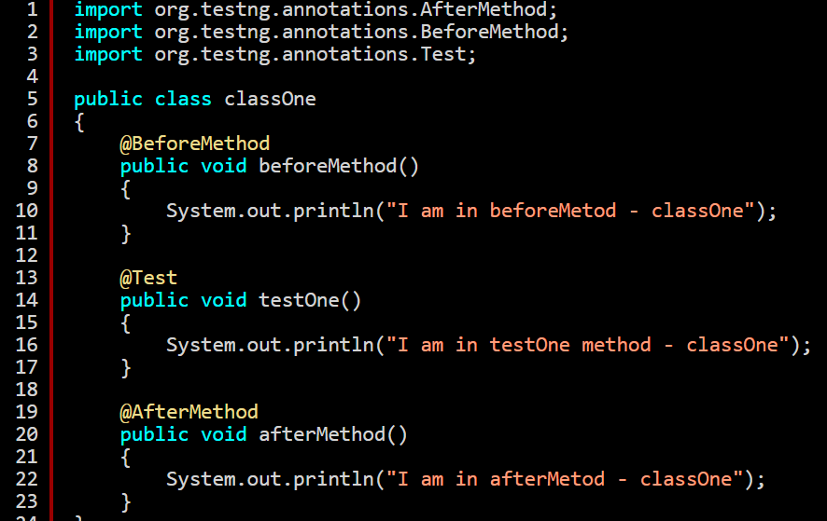
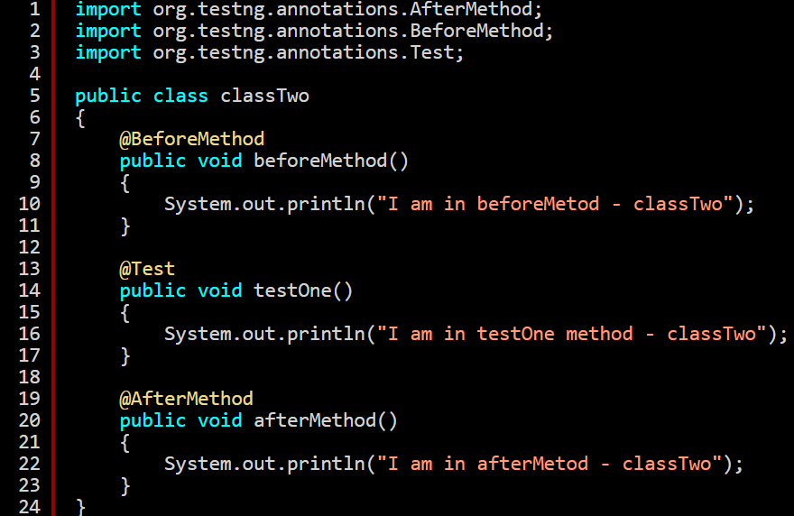
Example of Parallel Execution
classOne.java
classTwo.java

Slide 26
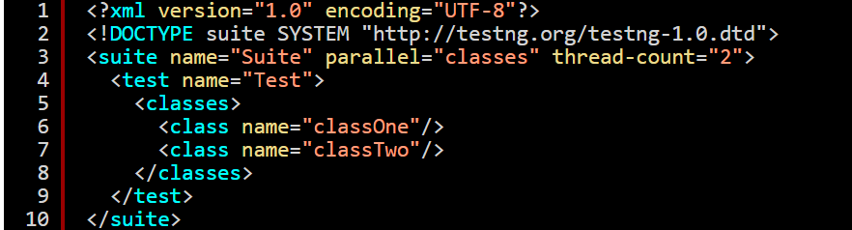
Example of Parallel Execution
testng.xml

Slide 27
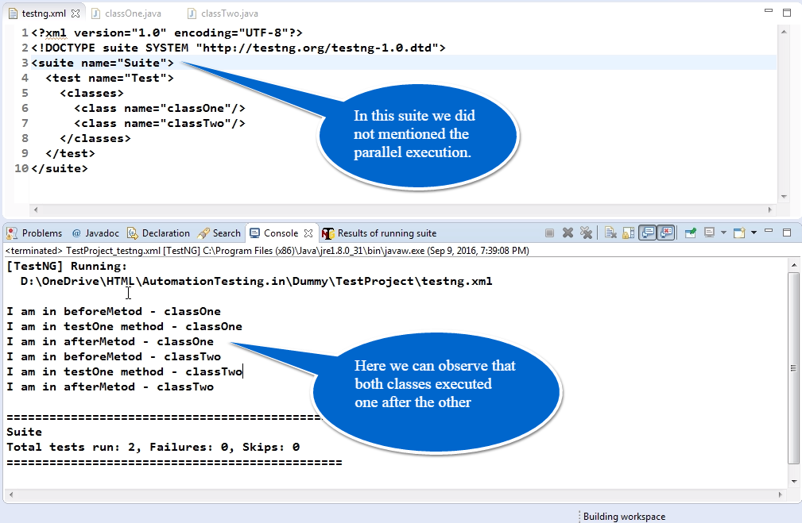
Example of Parallel Execution
Output without Parallel Execution

Slide 28
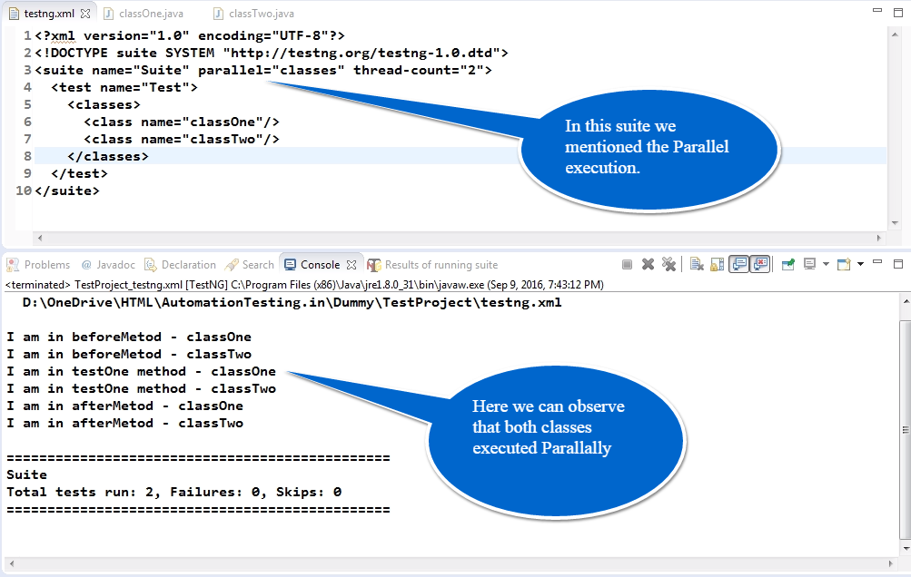
Example of Parallel Execution
Output with Parallel Execution

Slide 29
TestNG HTML Reports
Why do we need reporting?
The aim of automation is not to use the application under test only we test the application as an automation tester, find bugs/issues and report it to the development team or higher management team.
Reporting software bugs and test case results here is important for the testing process.
TestNG Reporting:
TestNG Reports are the default HTML reports which are generated once the test cases are executed using TestNG. These reports help you to identify the information about test cases and the status of a project. TestNG reports in Selenium have three methods passTest, failTest, and skipTest to check the data about test cases.
Report generation is very important when you are doing the Automation Testing as well as for Manual Testing.

Slide 30
TestNG HTML Reports
Two types of reports generated using TestNG:
Index.html: This is the full report of the currently executed script, which includes error, group, time, reporter logs, XPL XML files with details.
emailable-report.html: This is a brief report of a currently executed script, highlighting the green test case messages (for pass exam cases) and red (for cases of failed testing).
The TestNG will generate the default report.
When you execute testng.xml file, and refresh the project. You will get test-output folder in that folder for reporting in TestNG.
Right click on the emailable-report.html and select the option. Open with the web browser.

Slide 31
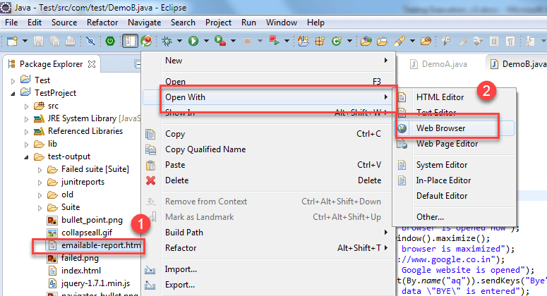
TestNG HTML Reports
Method-1: emailable-report.html
Click on option "emailable-report.html"
Click on option web browser

Slide 32
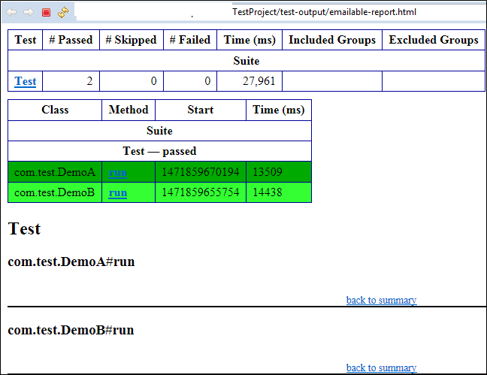
TestNG HTML Reports
The output reports in TestNG reporting will look like below if both the classes are passed:

Slide 33
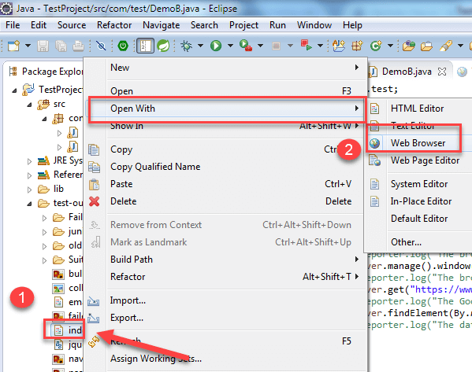
TestNG HTML Reports
Method-2: index.html
Right click on the index.html from the project directory.
Select option open with web browser option. It will display the result in the following order

Slide 34
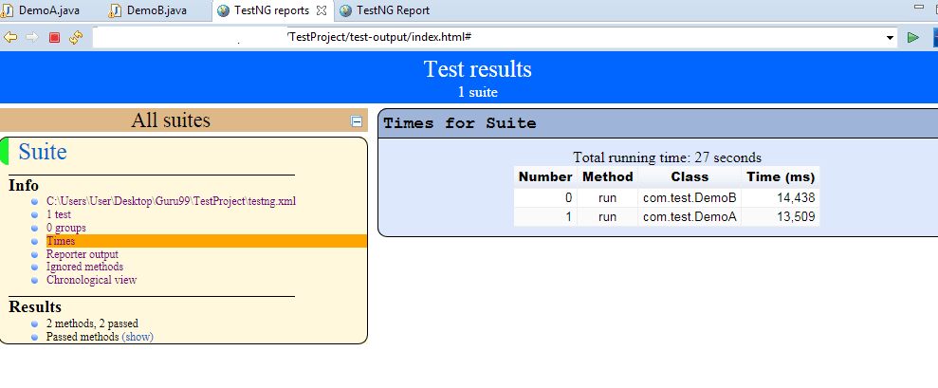
TestNG HTML Reports
The output reports in TestNG reporting will look like below if both the classes are passed:

Slide 35
Reference
TestNG Introduction and Overview.
https://www.guru99.com/
https://testng.org/doc/
TestNG Installation.
https://www.guru99.com/install-testng-in-eclipse.html
Contact Us
Deepak Tripathi– deepak.b.tripathi@capgemini.com

Slide 36

Thank you

